Slide 1
Elasticsearch #2 Searching

Slide 2
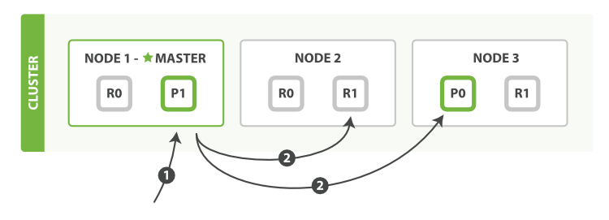
Cluster search
1. Query goes to Node1 for getting 10 documents
2. Node searches for all shards for 10 documents
3. Results goes back to Node1 where those 20 documents (10 * num_of_shards) are sorted
4. Response is send back to client

Slide 3
Cluster search phases
Query phase – searching node requests ALL shards asking for match
Result is document id and few field values (sorting) and relevance
Fetch phase – After sorting “global” result, searching node asks for full document to shards with relevant docs (1 or ALL)
In previous versions, behaviour could have been changed (fetch all at once), but was deprecated

Slide 4
Search API
Search across all indices and types
GET _search
Search across all types in author index
GET author/_search
Search in author index of books type
GET author/book/_search
Search in multiple indices and types
GET author,movie/book,director/_search

Slide 5
Search API options
timeout – after reaching given time, search node returns all result it got
from/size – paging options
preference – control which shard will participate in search (_primary, _shard etc)
explain – show detailed calculation how score was created for returned result
scroll – batch search with “preserved results” – newer docs are not visible
search_after – database seek, similar to scroll but search hits actual documents
min_score – lowest score possible for returning hits

Slide 6
Exercise #1
Create index cities with fields name, population, path
Place there following cities:
Prague, 1000000, /europe/czech_republic/prague
Paris, 2244000, /europe/france/paris
San Antonio, 1500000, /north_america/usa/san_antonio
San Francisco, 860000, /north_america/usa/san_Francisco
Practise size, limit, scroll options in match_all query
Practise multi index / multi term search with cities and author
Practise term, terms,range,query_string and match query

Slide 7
Analyzer
Analyzer - combination of character filters (0-n), tokenizer (1), and token filters(0-n)
Character filter – convert/add/remove characters (special chars, HTML)
Tokenizer – receive stream of chars and breaks it into stream of tokens
whitespace: “Hello world” -> [“Hello”, “world”]
Token filter – receive stream of tokens and may add/remove/convert tokens
lowercase: [“Hello”, “world”] -> [“hello”, “world”]

Slide 8
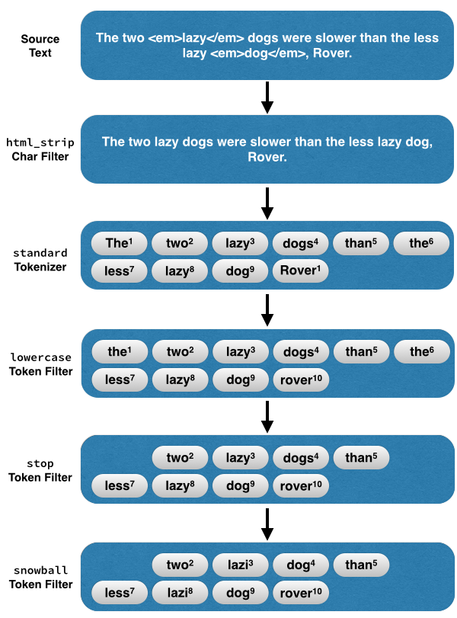
Analyze example

Slide 9
Search concept – inverted index
Star Trek
ID | Token | Document
1 | star | 1,2
2 | war | 2,3
3 | world | 3
Star Wars
War of the Worlds

Slide 10
Analyze
We can test/play with analyzers through API
GET _analyze {
“analyzer” : “standard”,
“tokenizer” : “keyword”,
“filter” : [“uppercase”],
“text” : [“hello world”, “quick brown fox”]
}

Slide 11
Text datatype mapping
type: text vs keyword
analyzer: how incoming text will be transformed into tokens
fields: indexing same text multiple ways (f.e. keyword, czech, ngram)
fielddata: true/false (default) – more in next slide
norms: true (default)/false – length of field info (useful for scoring)
index_options: additional information added to inverted index
docs – only doc id is stored (“does this term exists in this doc?”)
freqs – term occurrence in doc (important for relevance)
positions – docs + freqs + term position in document (span queries, phrases, approximity queries)
offsets – positions + offset (mapping to exact position in original text, useful for highlighting)
term_vector: vector information about document terms

Slide 12
FieldData
Logical map of document -> terms (inversion of inverted index ☺)
Used for sorting and aggregations, script usage
“What is the value for this document”?
Used only for text values (keyword has doc_values)
Is build on demand once first used

Slide 13
Mapping #2 – dynamic mapping
_default_ - default type settings, works as template
date_detection – when new field is send as text,tries to detect date format
numeric_detection – same as date_detection but for numbers
dynamic_templates – pattern and type matching rules for setting field configuration (if name* => type : text with keyword fields)

Slide 14
Mapping #2 – index templates
_default_ - default type settings, works as template
date_detection – when new field is send as text,tries to detect date format
numeric_detection – same as date_detection but for numbers
dynamic_templates – pattern and type matching rules for setting field configuration (if name* => type : text with keyword fields)

Slide 15
Mapping is important!
Never use dynamic mapping in production!
Fields allows you to have multiple analysed fields the for same value
Same field name can be shared among multiple types, however it must have same field type (text, integer etc)!!!
Index types will be removed in 7.0.0!

Slide 16
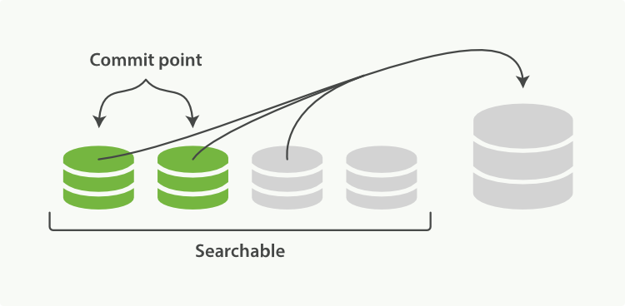
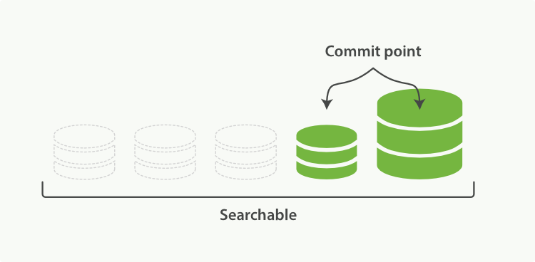
Merging

Slide 17
Relevance scoring
How frequent is the term in this document (TF – term frequency)
(more => higher score)
How frequent is the term in ALL documents (IDF – inverse document freq)
(less => higher score)
How much terms are in this document (Length norm)
(less => higher score)
By default Elastic uses BM25
https://www.elastic.co/guide/en/elasticsearch/reference/current/index-modules-similarity.html
https://www.elastic.co/blog/found-bm-vs-lucene-default-similarity

Slide 18
Queries
Filters
relevance
full text
cached
slower
yes/no match
exact values
cached
faster

Slide 19
INSTRUCTIONS FOR USE
EDIT IN GOOGLE SLIDES
Click on the button under the presentation preview that says "Use as Google Slides Theme".
You will get a copy of this document on your Google Drive and will be able to edit, add or delete slides.
You have to be signed in to your Google account.
EDIT IN POWERPOINT®
Click on the button under the presentation preview that says "Download as PowerPoint template". You will get a .pptx file that you can edit in PowerPoint.
Remember to download and install the fonts used in this presentation (you’ll find the links to the font files needed in the Presentation design slide)
More info on how to use this template at www.slidescarnival.com/help-use-presentation-template
This template is free to use under Creative Commons Attribution license. You can keep the Credits slide or mention SlidesCarnival and other resources used in a slide footer.

Slide 20
HELLO!
I am Jayden Smith
I am here because I love to give presentations. You can find me at @username

Slide 21
1.
TRANSITION HEADLINE
Let’s start with the first set of slides

Slide 22
Quotations are commonly printed as a means of inspiration and to invoke philosophical thoughts from the reader.

Slide 23
THIS IS A SLIDE TITLE
Here you have a list of items
And some text
But remember not to overload your slides with content
Your audience will listen to you or read the content, but won’t do both.

Slide 24
BIG CONCEPT
Bring the attention of your audience over a key concept using icons or illustrations

Slide 25
YOU CAN ALSO SPLIT YOUR CONTENT
White
Is the color of milk and fresh snow, the color produced by the combination of all the colors of the visible spectrum.
Black
Is the color of coal, ebony, and of outer space. It is the darkest color, the result of the absence of or complete absorption of light.

Slide 26
IN TWO OR THREE COLUMNS
Yellow
Is the color of gold, butter and ripe lemons. In the spectrum of visible light, yellow is found between green and orange.
Blue
Is the colour of the clear sky and the deep sea. It is located between violet and green on the optical spectrum.
Red
Is the color of blood, and because of this it has historically been associated with sacrifice, danger and courage.

Slide 27
A PICTURE IS WORTH A THOUSAND WORDS
A complex idea can be conveyed with just a single still image, namely making it possible to absorb large amounts of data quickly.

Slide 28
WANT BIG IMPACT?
Use big image.

Slide 29
USE CHARTS TO EXPLAIN YOUR IDEAS
WHITE
GRAY
BLACK

Slide 30
OR USE DIAGRAMS TO EXPLAIN COMPLEX IDEAS
Diagram featured by http://slidemodel.com
Sample Text
Sample Text
Sample Text
Sample Text

Slide 31
AND TABLES TO COMPARE DATA
 | A | B | C
Yellow | 10 | 20 | 7
Blue | 30 | 15 | 10
Orange | 5 | 24 | 16

Slide 32

MAPS
our office

Slide 33
89,526,124
Whoa! That’s a big number, aren’t you proud?

Slide 34
89,526,124$
185,244 users
100%
That’s a lot of money
And a lot of users
Total success!

Slide 35
OUR PROCESS IS EASY
First
Second
Last

Slide 36
LET’S REVIEW SOME CONCEPTS
Yellow
Is the color of gold, butter and ripe lemons. In the spectrum of visible light, yellow is found between green and orange.
Blue
Is the colour of the clear sky and the deep sea. It is located between violet and green on the optical spectrum.
Red
Is the color of blood, and because of this it has historically been associated with sacrifice, danger and courage.
Yellow
Is the color of gold, butter and ripe lemons. In the spectrum of visible light, yellow is found between green and orange.
Blue
Is the colour of the clear sky and the deep sea. It is located between violet and green on the optical spectrum.
Red
Is the color of blood, and because of this it has historically been associated with sacrifice, danger and courage.

Slide 37
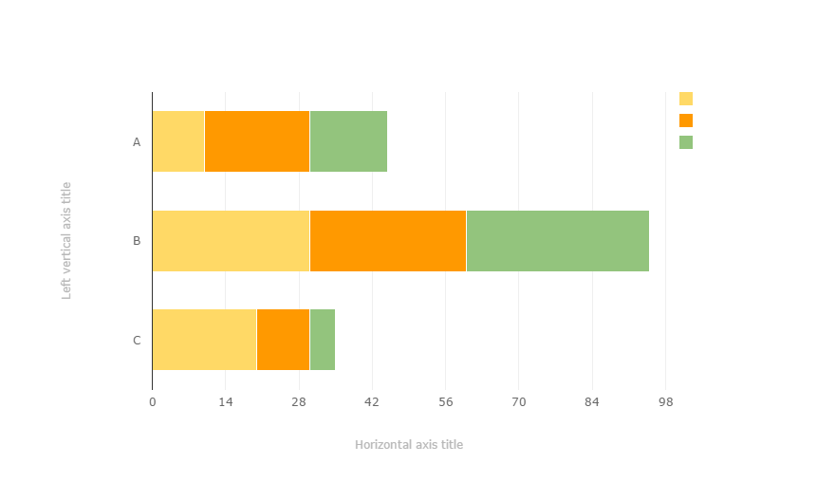
You can copy&paste graphs from Google Sheets

Slide 38
ANDROID PROJECT
Place your screenshot here
Show and explain your web, app or software projects using these gadget templates.

Slide 39
IPHONE PROJECT
Place your screenshot here
Show and explain your web, app or software projects using these gadget templates.

Slide 40
TABLET PROJECT
Place your screenshot here
Show and explain your web, app or software projects using these gadget templates.

Slide 41
DESKTOP PROJECT
Place your screenshot here
Show and explain your web, app or software projects using these gadget templates.

Slide 42
THANKS!
Any questions?
You can find me at @username & user@mail.me

Slide 43
CREDITS
Special thanks to all the people who made and released these awesome resources for free:
Presentation template by SlidesCarnival
Photographs by Death to the Stock Photo (license)

Slide 44

PRESENTATION DESIGN
You don’t need to keep this slide in your presentation. It’s only here to serve you as a design guide if you need to create new slides or download the fonts to edit the presentation in PowerPoint®
This presentations uses the following typographies and colors:
Titles: Montserrat
Body copy: Karla
You can download the fonts on this page:
http://www.google.com/fonts/#UsePlace:use/Collection:Montserrat:400,700|Karla:400,400italic,700,700italic
Click on the “arrow button” that appears on the top right
Red #F44336 Deep orange #FF5722 Orange #FF9800 Amber #FFC107
Yellow #FFEB3B Lime #CDDC39 Green #8BC34A Dark green #4CAF50
Teal #009688 Cyan #00BCD4 Blue #03A9F4 Dark blue #2196F3
Indigo #3F51B5 Deep Purple #673AB7 Purple #9C27B0 Magenta #E91E63
Blue gray #607D8B

Slide 45
SlidesCarnival icons are editable shapes.
This means that you can:
Resize them without losing quality.
Change line color, width and style.
Isn’t that nice? :)
Examples:

Slide 46
😉
Now you can use any emoji as an icon!
And of course it resizes without losing quality and you can change the color.
How? Follow Google instructions https://twitter.com/googledocs/status/730087240156643328
✋👆👉👍👤👦👧👨👩👪💃🏃💑❤😂😉😋😒😭👶😸🐟🍒🍔💣📌📖🔨🎃🎈🎨🏈🏰🌏🔌🔑 and many more...

